Slide 1

Baguio City Ordinance Tracker Web Database System
About
The purpose of Web-based ordinance tracker and database system for Sangguninang Panglunsod is to have a simpler, faster and more user-friendly System for both the staffs and the public.
Sangguniang Panlungsod Interns (Baguio College of Technology)

Slide 2

About
The purpose of Web-based ordinance tracker and database system for Sangguninang Panlungsod is to have a simpler, faster and more user-friendly System for both the staffs and the public.

Slide 3
Baguio City Ordinance Tracker Web Database System
About
The purpose of Web-based ordinance tracker and database system for Sangguninang Panglunsod is to have a simpler, faster and more user-friendly System for both the staffs and the public.
Sangguniang Panlungsod Interns (Baguio College of Technology)

Slide 4
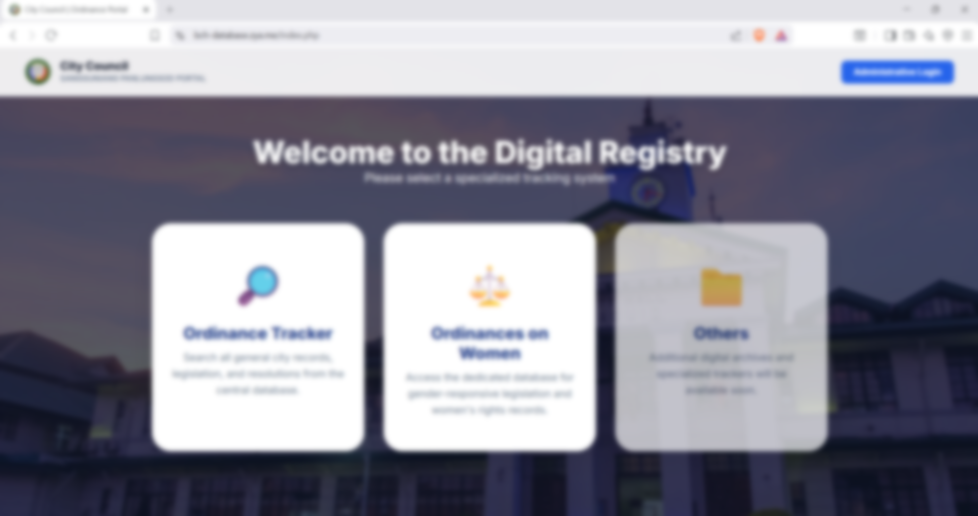
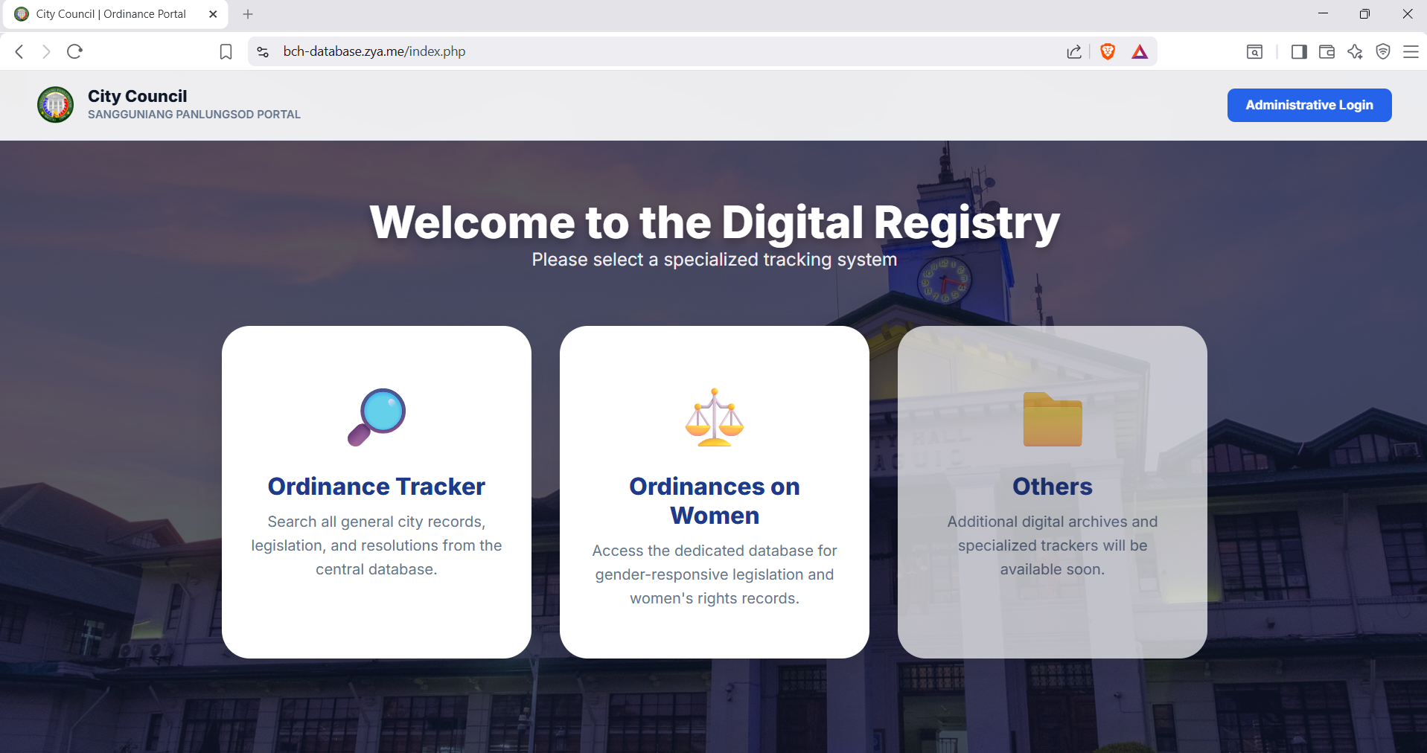
About
The purpose of Web-based ordinance tracker and database system for Sangguninang Panglunsod is to have a simpler, faster and more user-friendly System for both the staffs and the public.

Slide 5
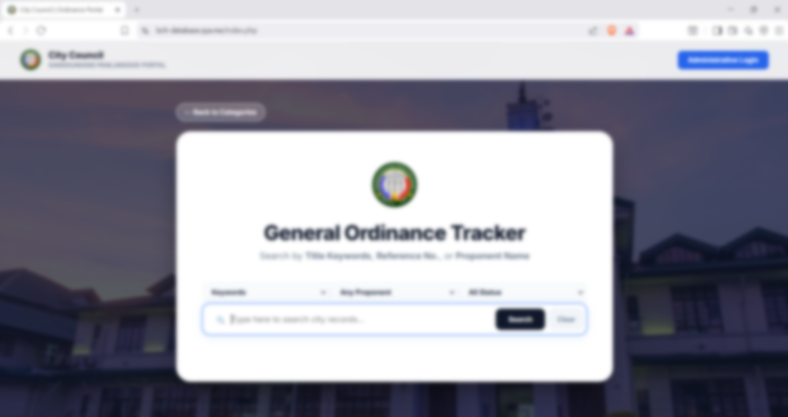
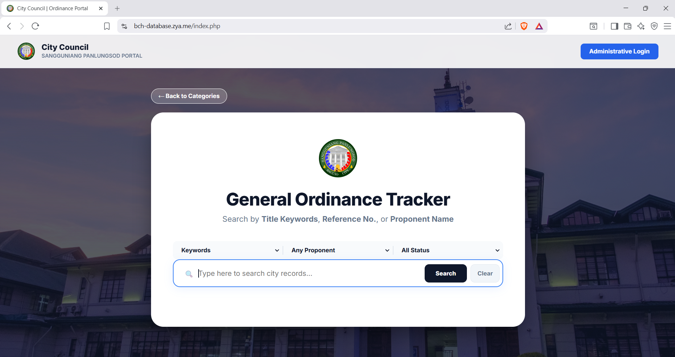
OUR COMPETITION
COMPETITORS
Our product is priced below that of other financial management tools on the market
Simple and easy to use app and website, compared to the complex tools of the competitors
Affordability is the main draw for our consumers to our product
Company A
Product is more expensive
Companies B & C
Product is expensive and inconvenient to use
Companies D & E
Product is affordable, but inconvenient to use

Slide 6

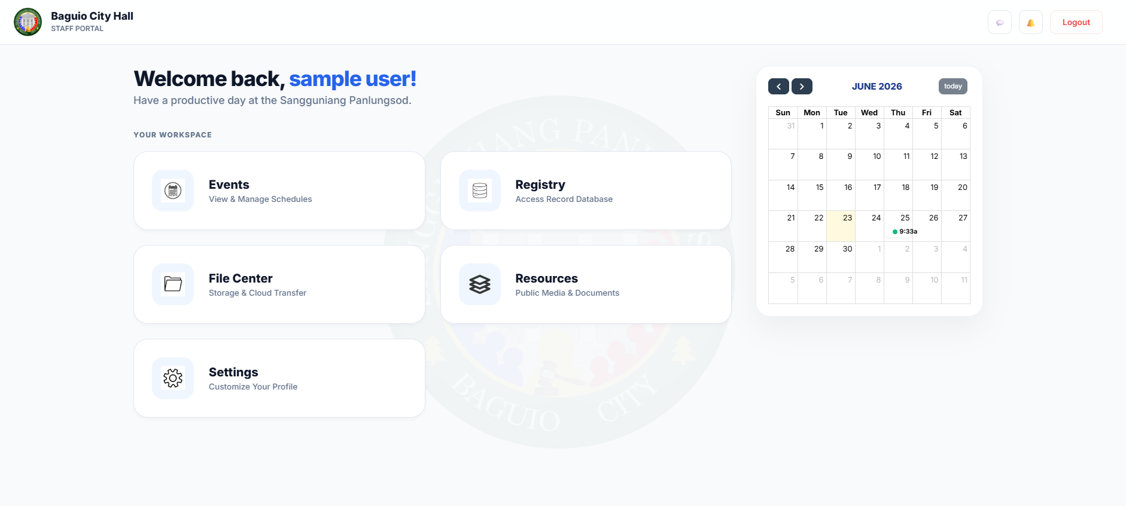

Slide 7

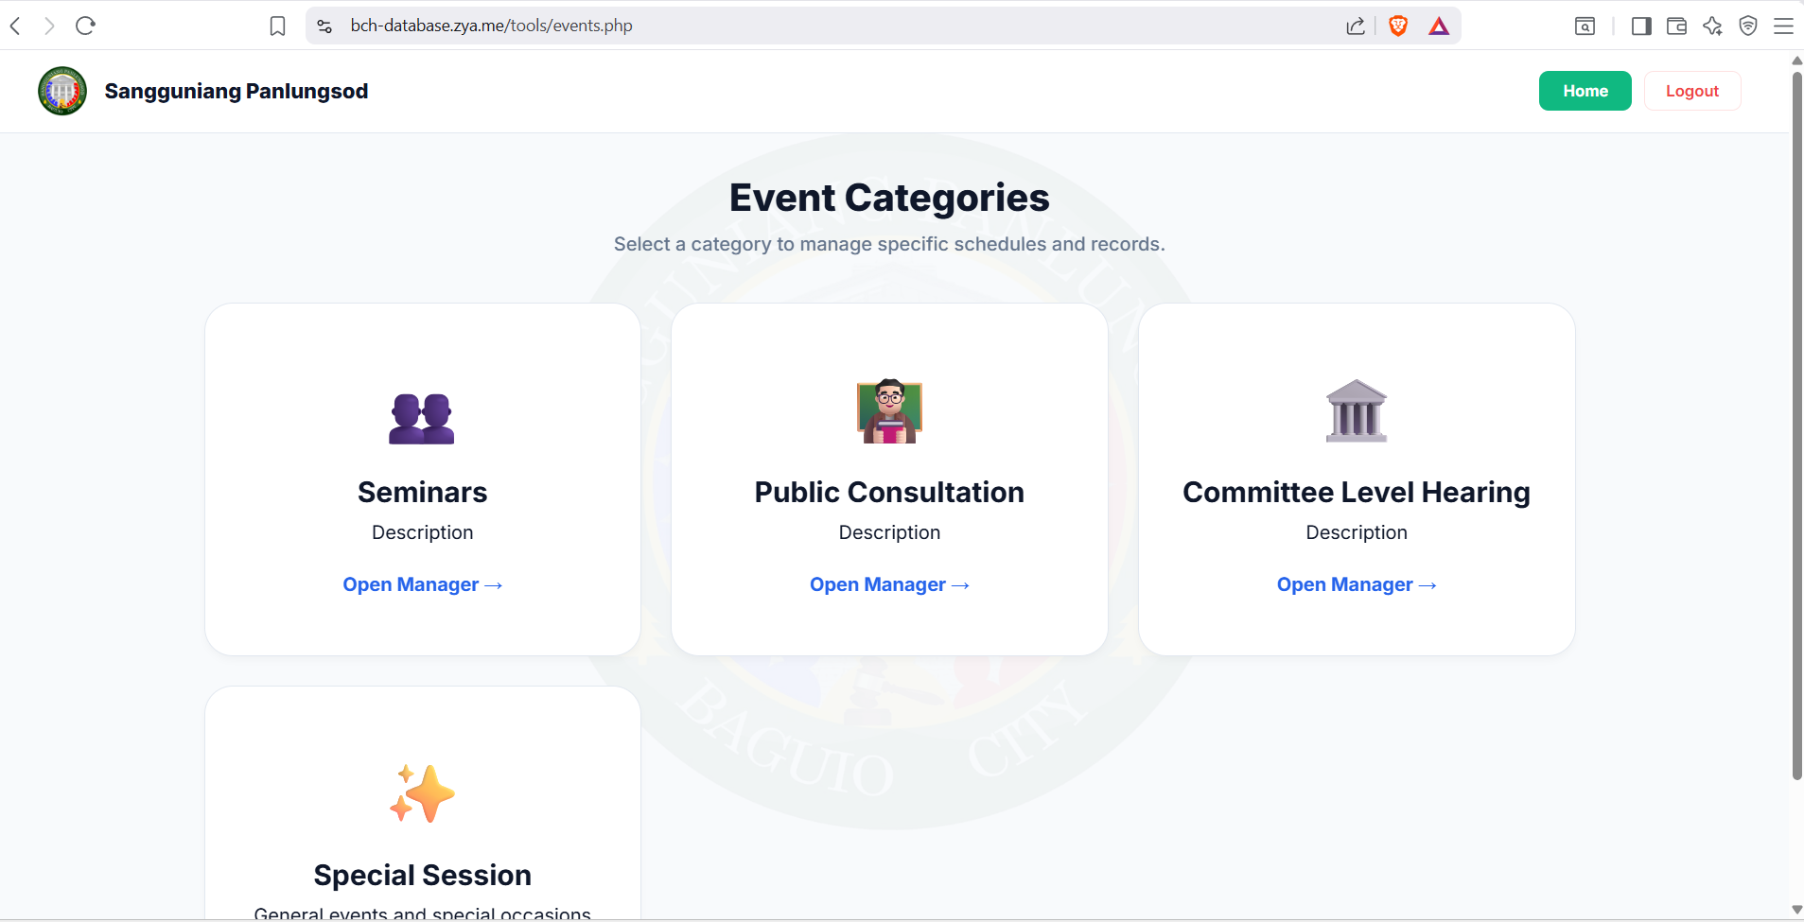

Slide 8

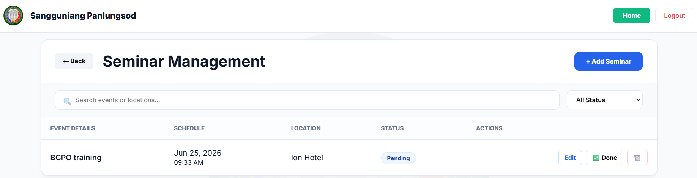

Slide 9
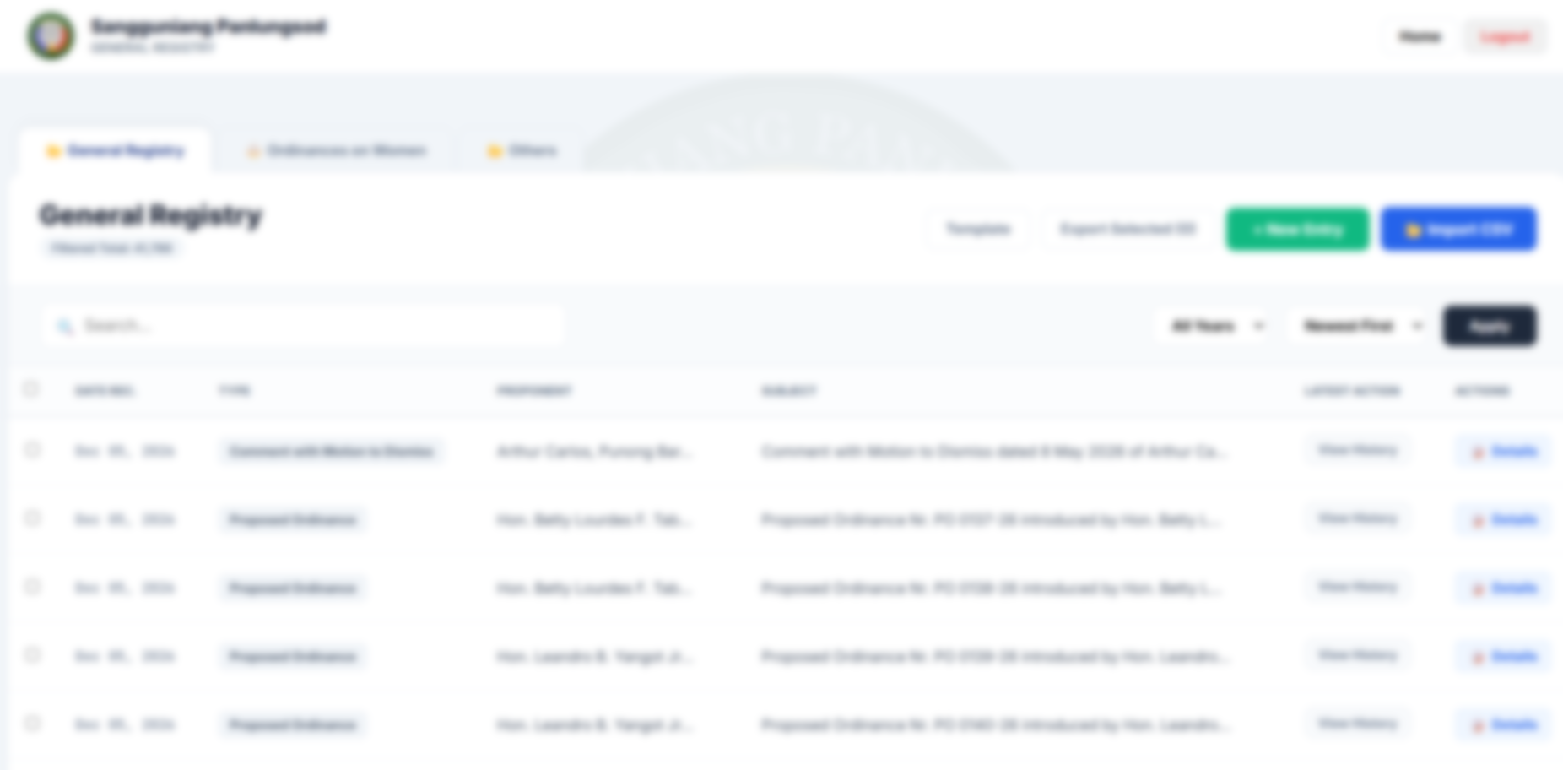
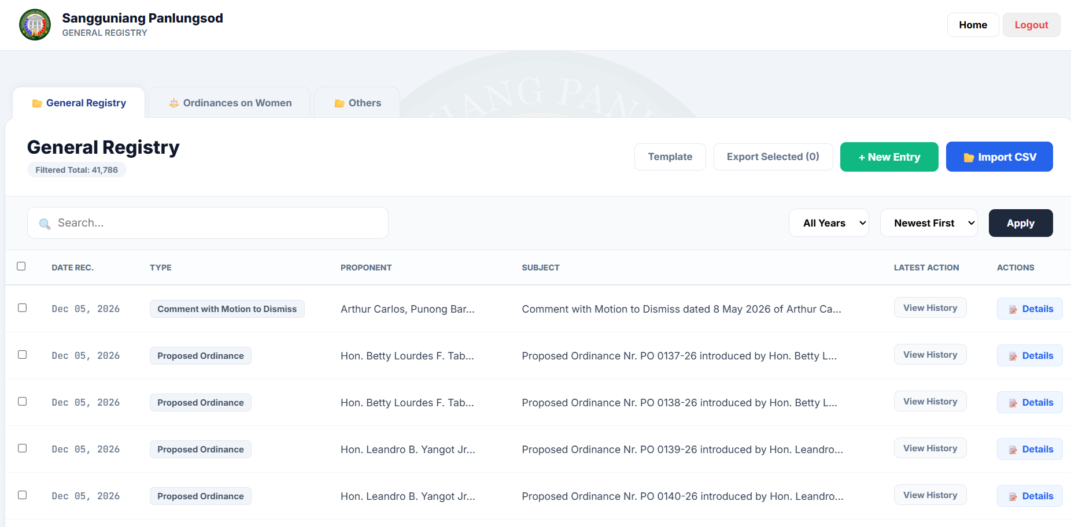

Slide 10
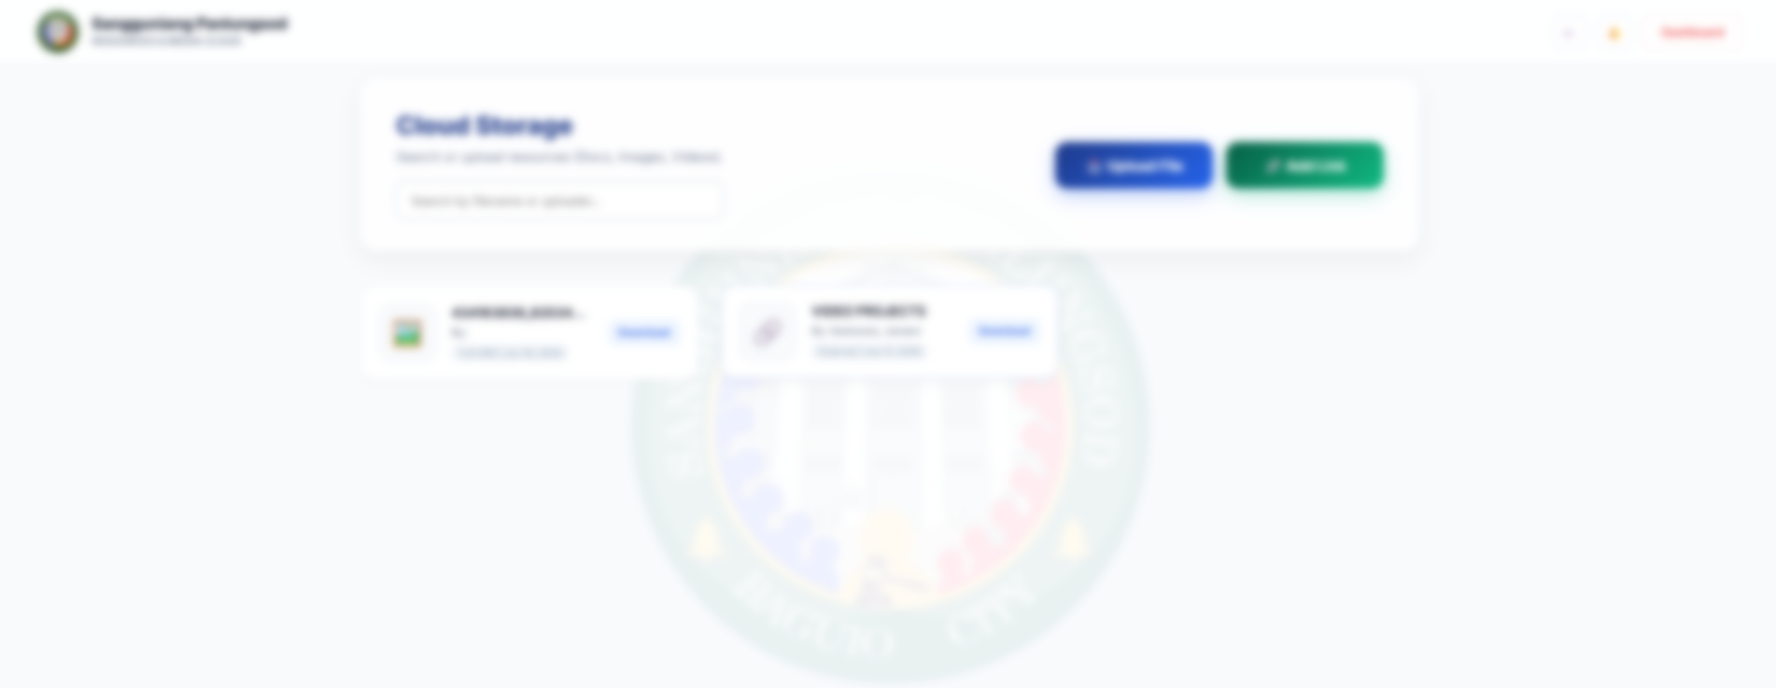


Slide 11

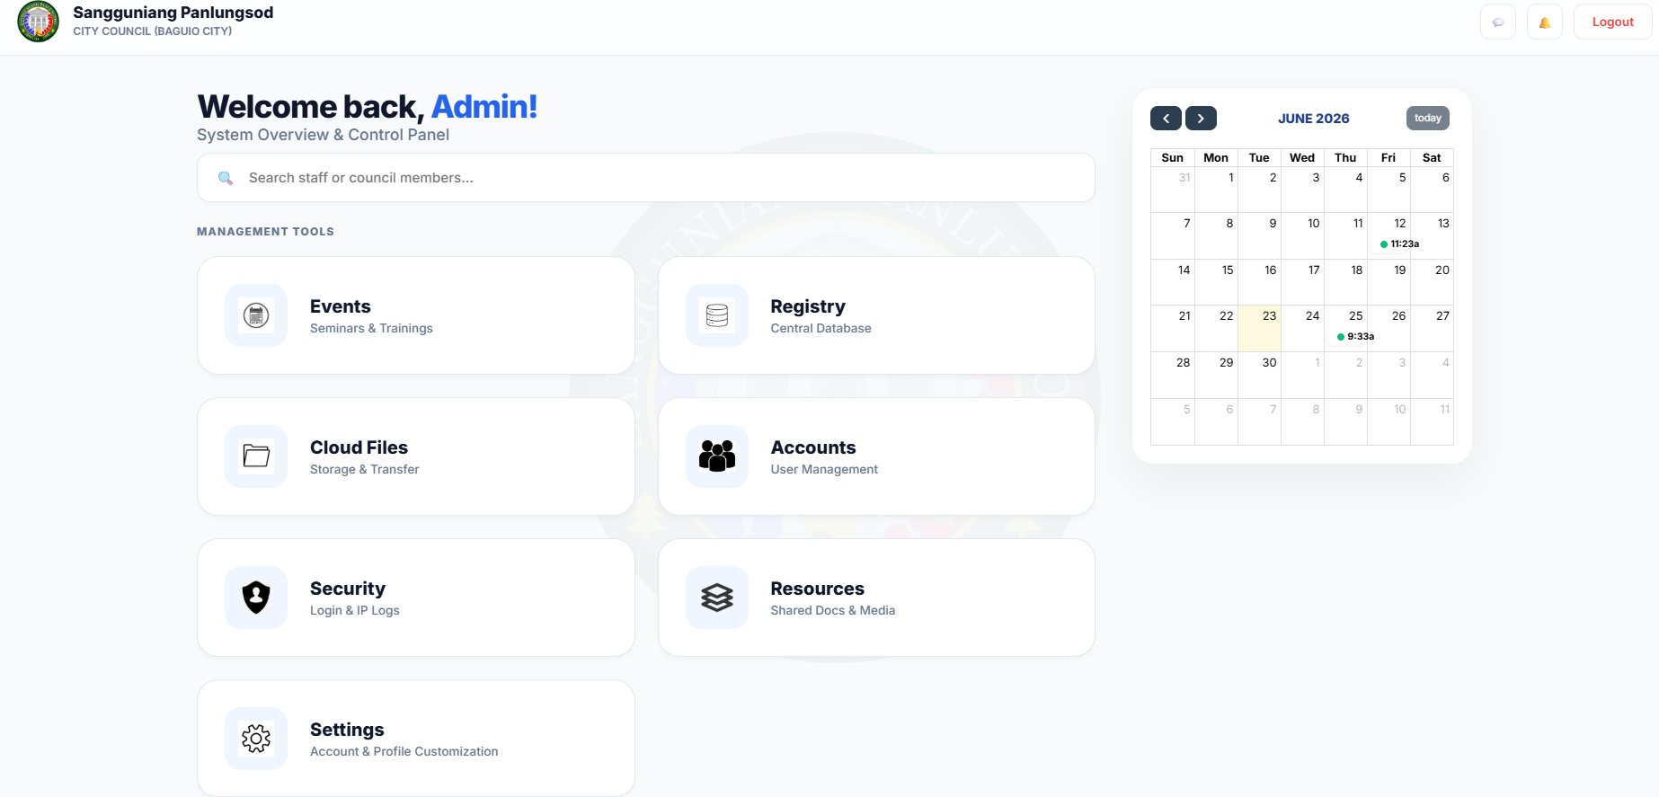

Slide 12


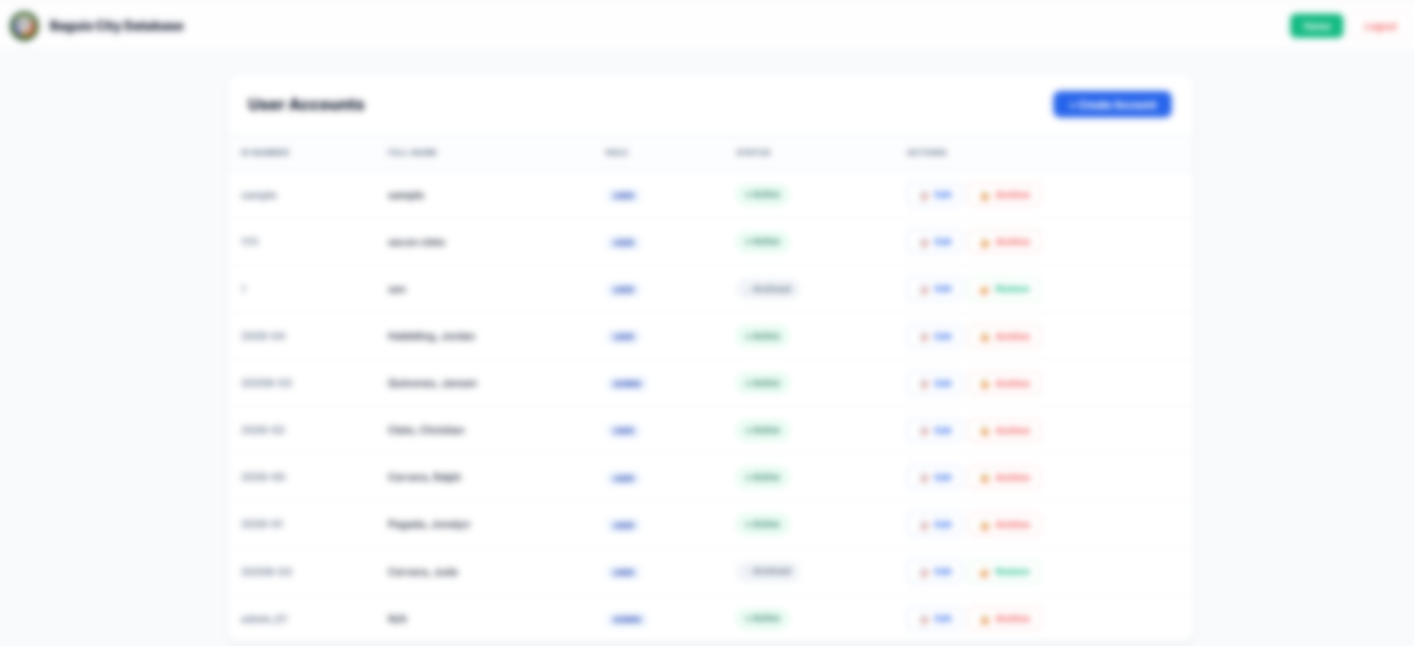
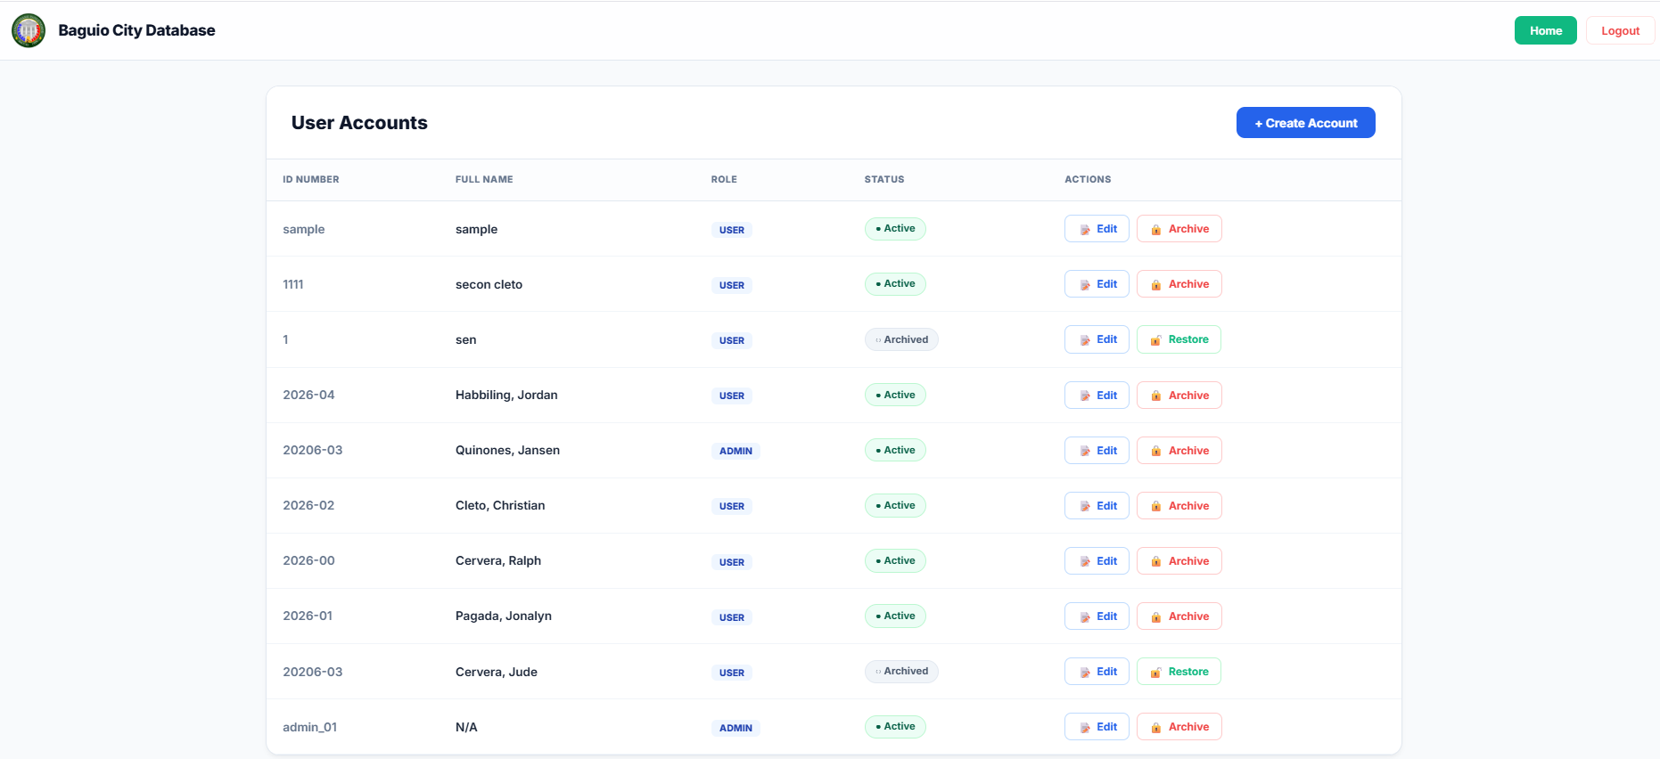

Slide 13
Baguio City Ordinance Tracker Web Database System
About
The purpose of Web-based ordinance tracker and database system for Sangguninang Panglunsod is to have a simpler, faster and more user-friendly System for both the staffs and the public.
Sangguniang Panlungsod Interns (Baguio College of Technology)

Slide 14
START

Slide 15
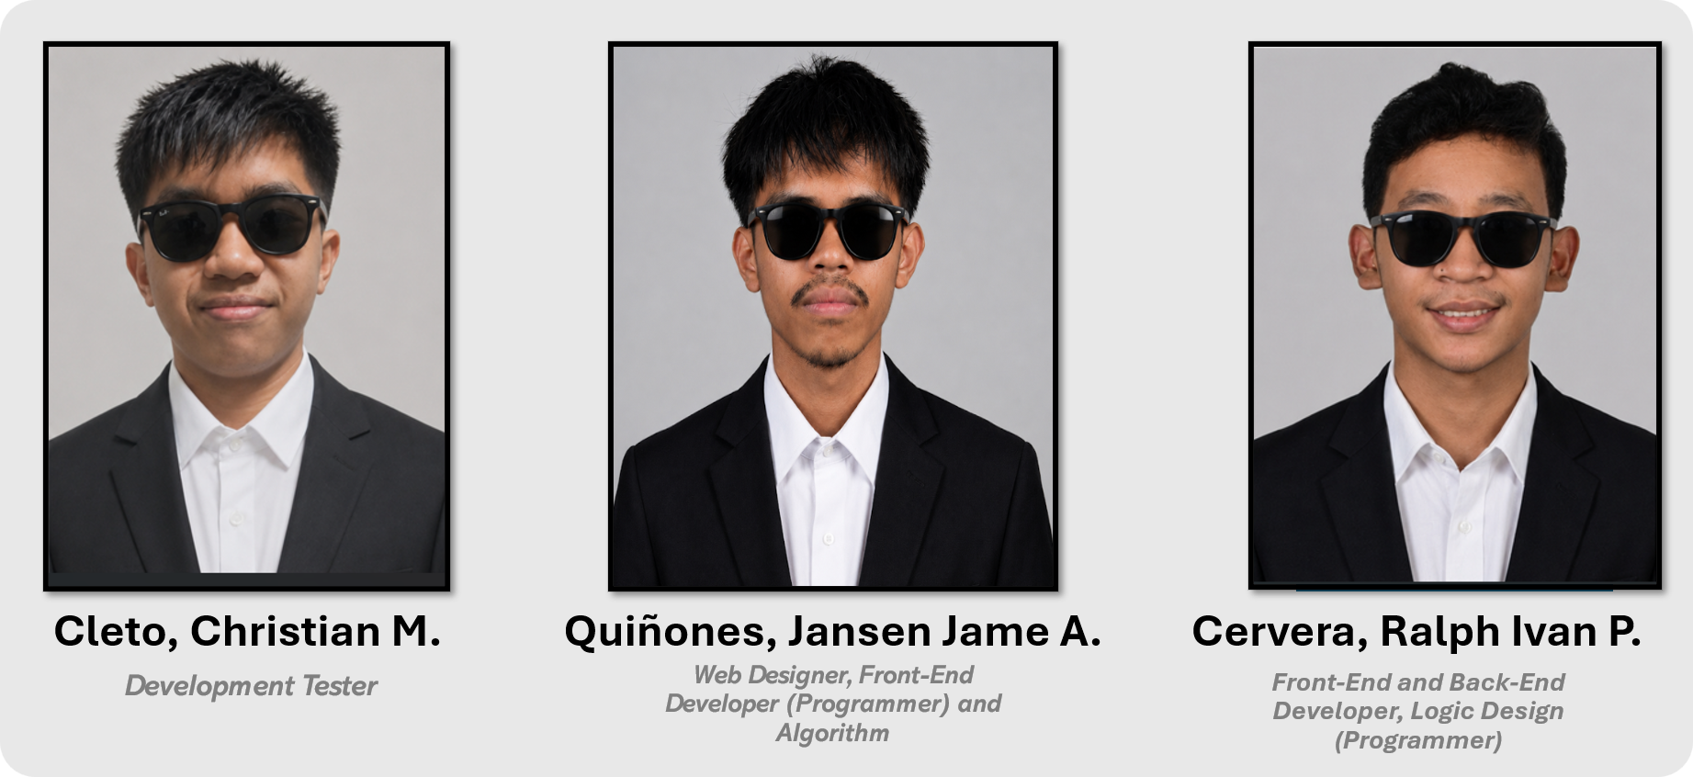
THE TEAM

Slide 16





THANK YOU FOR LISTENING!!

Slide 17
Baguio City Ordinance Tracker Web Database System
About
The purpose of Web-based ordinance tracker and database system for Sangguninang Panglunsod is to have a simpler, faster and more user-friendly System for both the staffs and the public.
Sangguniang Panlungsod Interns (Baguio College of Technology)

